Slide 1
RMBS Database
Overview
KROLL BOND RATING AGENCY, INC

Slide 2
OVERVIEW
Business Intelligence
Purpose
Tools
Basic Artifacts
Star Schema
Table Partitions
Columnstore
Window functions
Star Schema
Fact Table: Stores measurements about a business, can be summed or averaged.
Narrow and deep
Rows are flowing in.
Dimension Tables: Categories used to group or classify metrics of a business
Wide and shallow
Fairly static
But Changes will occur, albeit slowly
Accept by overwriting an existing row
Accept by adding a new row
Accept by adding a new column
Database Structures
Partitioning
Scheme
Function
Columnstore Index
Save space
Speed retrieval

Slide 3
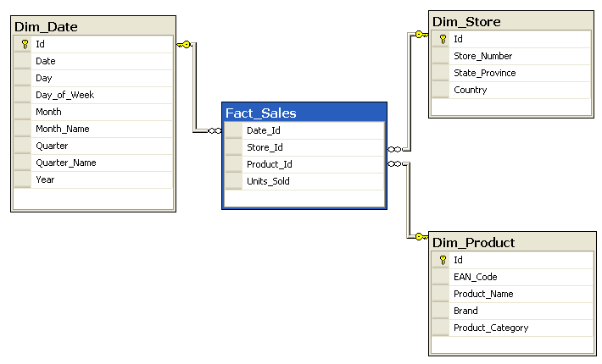
Star Schema

Slide 4
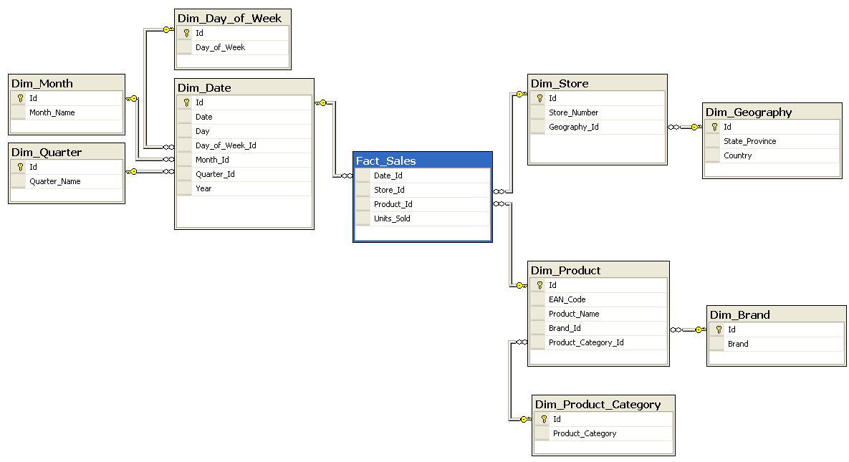
Snow flaked

Slide 5
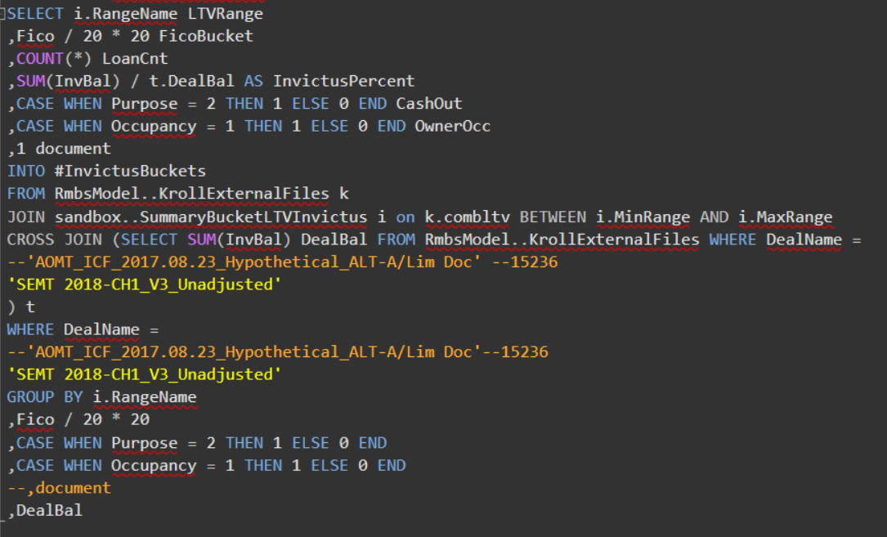
Query with Aggregates

Slide 6
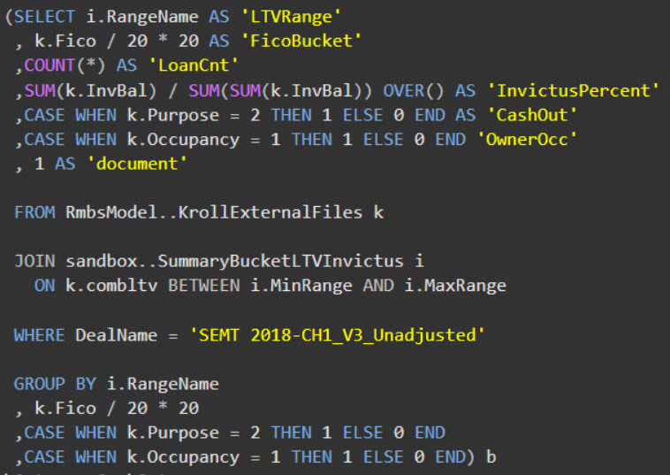
Query with Aggregates

Slide 7
Closing
Data Warehousing
Star Schema
Snowflakes
Database
Table Partitions
Schemes
Functions
Columnstore
Key columns
Included columns
Data Analysis
Power Pivot (Excel)
Power BI
Tableau
Python
R/RStudio
Linear Regression
Logistic Regression
PCA
Bayesian Classification
Cluster Analysis

